Slide 1
Inter process Synchronization
- P N

Slide 2
Primary Forms of Explicit Inter process Interaction
Inter Process Synchronization:
A set of protocols and mechanism used to preserve system integrity and consistency when concurrent processes share resources that are serially reusable.
A Serially reusable resource can be used by at most one process at a time. Its state and possibly its operation, can be corrupted if manipulated concurrently and without synchronization by more than one process.
Eg: read/write shared variables and devices such as printers.

Slide 3
Inter Process Signaling:
The exchange of time signals among concurrent processes or threads, used to coordinate their collective progress. Signaling is a rudimentary but common form of inter process synchronization.
Inter Process communication:
Concurrent communicating processes must communicate for such purposes as exchanging data, reporting progress, and accumulating collective results. Shared Memory, which is accessible to all participants, provides a simple and common means of inter process communication.
To prevent timing errors, concurrent processes must synchronize their accessing of shared memory.

Slide 4
Need for Inter process Synchronization
The use of shared variables is a common form of communication among cooperating processes.
When a set of processes have access to common address space, they can use shared variables for a number of purposes, such as signalling flags and accumulating collective results.
However, unrestricted updating of shared variables can lead to inconsistencies.
Such errors are often dependent on the specific timing and interleaving of process actions.
As a result, concurrency-induced errors can be extremely difficult to detect, reproduce and debug.

Slide 5
Example
KEYBOARD increments the variable ECHO for each character input:
{Process Keyboard}
......
echo:= echo+1:
......
And DISPLAY decrements ECHO for every character displayed:
{Process Display}
......
echo:=echo-1;
......

Slide 6
Mutual Exclusion
A single process temporarily excludes all others from using a shared resource in order to ensure the system’s integrity.
A Critical Section is a sequence of instructions with a clearly marked beginning and end. It usually safeguards updating of one or more shared variable.
If the shared resource is a variable, mutual exclusion ensures that at most one process at a time has access to it during the critical updates that lead to temporarily inconsistent values.
Consequently, other processes see only consistent values of shared variables.

Slide 7
To be acceptable as general tool, a solution to the mutual exclusion problem should:
Ensure mutual exclusion between processes accessing the protected shared resource.
Make no assumptions about relative speeds and priorities of contending processes.
Guarantee that crashing or terminating of any process outside of its critical section does not affect the ability of other contending processes to access the shared resource.
When more than one process wishes to enter the critical section grant entrance to one of them in finite time.

Slide 8
In many approaches to mutual exclusion, each process observes the following basic protocol:
negotiation protocol; ........{winner proceeds}
critical section; ................{exclusive use of resource}
release protocol; ...............{ownership relinquished}

Slide 9
The First Algorithm
Process P1;
Begin
While true do
Begin
While turn =proc2 do {keep testing}
Critical section;
Turn:=proc 2;
Other_p1_processing
End {while}
End {p1}
Process p2
Begin
While true do
Begin
While turn =proc1 do {keep testing}
Critical section;
Turn:=proc 1;
Other_p2_processing
End {while}
End {p2}
{parent process}
Begin {mutex1}
Turn: =.....;
Initiate p1,p2
End {mutex1}

Slide 10
The Second algorithm
Process P1
Begin
While true do
Begin
While p2using do {keep testing}
P1using := true;
Critical section;
P1using:=false;
Other_p1_processing
End {while}
End {p1}
Process P2
Begin
While true do
Begin
While p1using do {keep testing}
P2using := true;
Critical section;
P2using:=false;
Other_p2_processing
End {while}
End {p1}
{parent process}
Begin {mutex 2}
P1using:= false
P2using:= false;
Initiate p1,p2
End {mutex 2}

Slide 11
The Third Algorithm
Process p1
Process p2
Begin
While true do
Begin
P1using:=true
While p2suing do {keep testing};
Critical section;
P1using:=false;
Other_p1_processing
End {while}
End; {p1}
Begin
While true do
Begin
P2using:=true
While p1using do {keep testing};
Critical section;
P2using:=false;
Other_p2_processing
End {while}
End; {p1}
{parent process}
Begin {mutex 3}
P1using:= false
P2using:= false;
Initiate p1,p2
End {mutex 3}

Slide 12
Semaphores
Dijkstra has proposed a mechanism for mutual exclusion among an arbitrary number of processes, called a “semaphore” .
A semaphore mechanism consists of the two primitive operations “SIGNAL” and “WAIT”, which operate on a special type of semaphore variable “s”.
The semaphore variable can assume integer values and except possibly for initialization, may be accessed and manipulated only by means of the SIGNAL and WAIT operations.

Slide 13
Wait (s);
decrements the value of its argument semaphore, s, as soon as it would become non negative.
Signal (s);
increments the value of its argument semaphore , s ,as an indivisible operation.
Wait (s): while not (s>0) do {keep testing};
s :=s-1;
Signal (s) : s:=s+1;

Slide 14
Contd...
A semaphore whose variable is allowed to take on only the values of 0 (busy) and 1 (free) are called as binary semaphore.
For binary semaphores, the logic of WAIT (s) should be interpreted as waiting until semaphore variable s becomes equal to FREE, followed by its indivisible setting to BUSY before control is returned to the caller.
The WAIT operation therefore implements the negotiation phase of the mutual exclusion.
SIGNAL sets the semaphore variable to FREE and thus represents the release phase of the mutual exclusion sequence

Slide 15
Contd...
The general semaphore may take any integer value.
The logic of WAIT and SIGNAL operations is applicable to both binary and general semaphores.

Slide 16
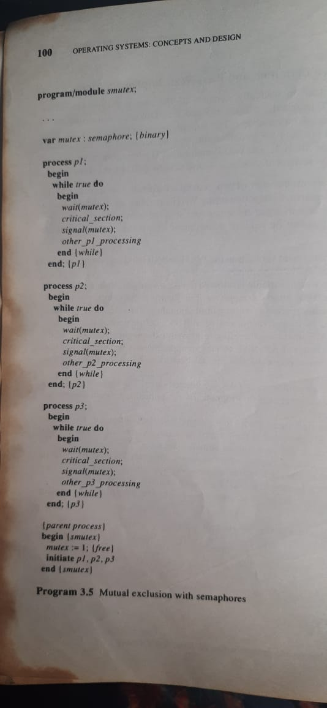

Slide 17
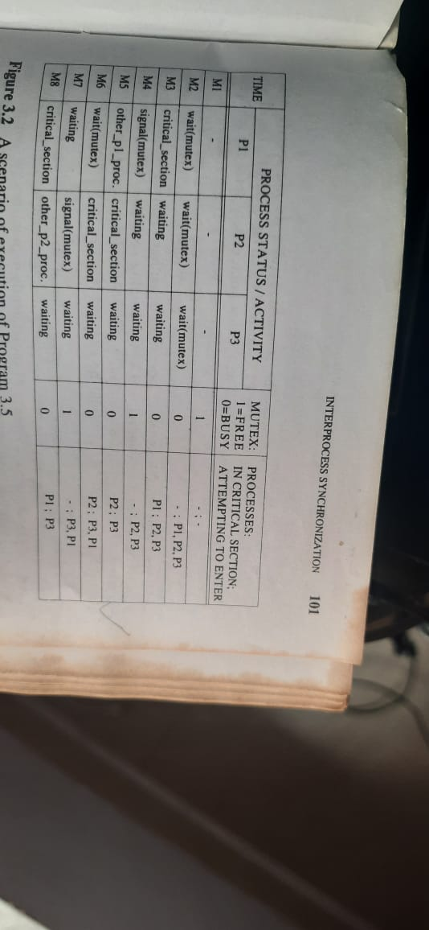

Slide 18
Semaphore Service Discipline
Busy-Wait semaphore definition does not impose any ordering among waiting processes.
Thus, there is a possibility that a process may be locked out due to contention with others.
This situation, in which some processes are making progress towards completion but one or more other processes are locked out of the resource is called indefinite postponement.
This phenomenon is also called as livelock, and the other processes are referred to as being starved.
To prevent livelocks, some semaphore implementations enforce a service discipline among the waiting processes.

Slide 19
Contd...Example:
Assuming that the process priority is a criterion for choosing a waiting process , and that process P1 and P2 have higher priority than P3, a continuation of the example may easily be constructed such that P3 never obtains a resource.
Process starvation may be prevented by adding the following requirement to semaphore implementation::
A request to enter the critical section must be granted in finite time.
Given the assumption that each process spends a finite time executing the critical section, this requirement can be met by using the FIFO discipline for choosing among the waiting processes.
Since it guarantees entrance to the critical section in finite time to all waiting processes, FIFO servicing is sometimes referred to as a strong implementation of semaphore.

Slide 20
Semaphore Granularity
The finest granularity is accomplished by dedicating a separate semaphore to guard each specific shared resource.
Granularity of semaphore can be made coarse by having each semaphore guard a collection of shared resources.

Slide 21
Critical Region & Conditional Critical Region
The problem is that semaphores are not syntactically related to the shared resources that they guard. In particular, there are no declarations that could alert the compiler that a specific data structure is shared and that its accessing needs to be controlled.
Brinch Hansen has proposed a language construct called critical region that alleviates this problem.
A critical region protects a shared data structure by making it known to the compiler, which can then generate code that maintains mutually exclusive access to the related data.

Slide 22
The declaration of a shared variable has the following format:
Var mutex: shared T;
Processes may access a guarded variable by means of the region construct as follows:
region mutex do

Slide 23
Monitors in Process Synchronization
Monitors are used for process synchronization. With the help of programming languages, we can use a monitor to achieve mutual exclusion among the processes.
monitors are defined as the construct of programming language, which helps in controlling shared data access.
The Monitor is a module or package which encapsulates shared data structure, procedures, and the synchronization between the concurrent procedure invocations.

Slide 24
Characteristics of Monitors.
Inside the monitors, we can only execute one process at a time.
Monitors are the group of procedures, and condition variables that are merged together in a special type of module.
If the process is running outside the monitor, then it cannot access the monitor’s internal variable. But a process can call the procedures of the monitor.
Monitors offer high-level of synchronization
Monitors were derived to simplify the complexity of synchronization problems.
There is only one process that can be active at a time inside the monitor.

Slide 25
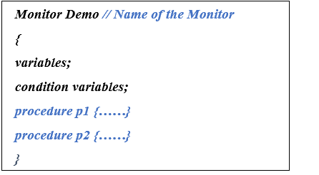
Syntax of monitor

Slide 26
Condition Variables
There are two types of operations that we can perform on the condition variables of the monitor:
Wait
Signal

Slide 27
Wait Operation
a.wait(): -
The process that performs wait operation on the condition variables are suspended and locate the suspended process in a block queue of that condition variable.
Signal Operation
a.signal() : -
If a signal operation is performed by the process on the condition variable, then a chance is provided to one of the blocked processes.

Slide 28
Difference between Monitors and Semaphore
Monitors | Semaphore
We can use condition variables only in the monitors. | In semaphore, we can use condition variables anywhere in the program, but we cannot use conditions variables in a semaphore.
In monitors, wait always block the caller. | In semaphore, wait does not always block the caller.
The monitors are comprised of the shared variables and the procedures which operate the shared variable. | The semaphore S value means the number of shared resources that are present in the system.
Condition variables are present in the monitor. | Condition variables are not present in the semaphore.

Slide 29
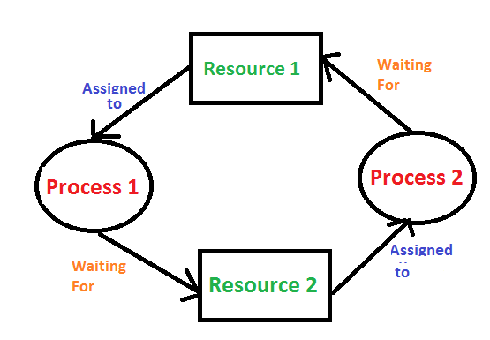
Deadlock
Deadlock is a situation where a set of processes are blocked because each process is holding a resource and waiting for another resource acquired by some other process.

Slide 30
Necessary conditions for Deadlock
Mutual Exclusion: Two or more resources are non-shareable (Only one process can use at a time)
Hold and Wait: A process is holding at least one resource and waiting for resources.
No Preemption: A resource cannot be taken from a process unless the process releases the resource.
Circular Wait: A set of processes are waiting for each other in circular form.

Slide 31
Deadlock Prevention
It is very important to prevent a deadlock before it can occur. So, the system checks each transaction before it is executed to make sure it does not lead to deadlock. If there is even a slight chance that a transaction may lead to deadlock in the future, it is never allowed to execute.

Slide 32
The problem with Deadlock Prevention method is that some of the resources may actually be used only during a portion of execution of the related process; say at beginning (card reader) or at the end (printer). Therefore, some resources can be idle for a long time.
Since pre-claiming the resource needs also has the tendency to overestimate resource requirements, deadlock prevention by means of advanced acquiring of all estimated resources can result in low resource utilization and in a corresponding reduction of the level of concurrency possible in the system.
An alternative is to acquire resource incrementally, as needed, and to prevent deadlocks by releasing all resources held by a process when it requests a temporarily unavailable resource.

Slide 33
Hold-and-wait:
This condition can be eliminated by requiring or forcing a process to release all resources held by it whenever it requests a resource that is not available.
There are basically 2 implementations of this strategy:
The process requests all needed resources prior to commencement of execution and
The process requests resources incrementally in the course of execution but releases all its resources holdings upon encountering a denial.

Slide 34
No Pre-emption
This condition can be denied by allowing pre-emption, that is, by authorizing the system to revoke ownership of certain resources from blocked processes.
Pre-emption is possible for certain types of resources, such as CPU and main memory, since the CPU portion of process state is routinely saved during the process switch operation and the contents of pre-empted memory pages can be swapped out to secondary storage.
Pre emption is possible only for certain types of resources and it can be applied when the benefits of deadlock prevention outweigh the cost of state save-restore operations. However, since some resources cannot safely preempted, this approach alone cannot provide complete deadlock prevention.

Slide 35
Circular- wait
In this approach, system resources are divided into different classes Cj, where j=1,2...n
Deadlocks are prevented by requiring all processes to request and acquire their resources in a strictly increasing order of the specified system resource classes.
Acquisition of all resources within a class must be made with a single request and not incrementally.
In other words, once a process acquires a resource belonging to class Cj, it can only request resources of class j+1 or higher, thereafter.

Slide 36
Deadlock Avoidance
It is better to avoid a deadlock rather than take measures after the deadlock has occurred. The wait for graph can be used for deadlock avoidance. This is however only useful for smaller databases as it can get quite complex in larger databases.

Slide 37
Deadlock Detection
A deadlock can be detected by a resource scheduler as it keeps track of all the resources that are allocated to different processes. After a deadlock is detected, it can be resolved using the following methods −
All the processes that are involved in the deadlock are terminated. This is not a good approach as all the progress made by the processes is destroyed.
Resources can be preempted from some processes and given to others till the deadlock is resolved.

Slide 38
Semaphore in OS is an integer value that indicates whether the resource required by the process is available or not.
The value of a semaphore is modified by wait() or signal() operation where the wait() operation decrements the value of semaphore and the signal() operation increments the value of the semaphore

Slide 39
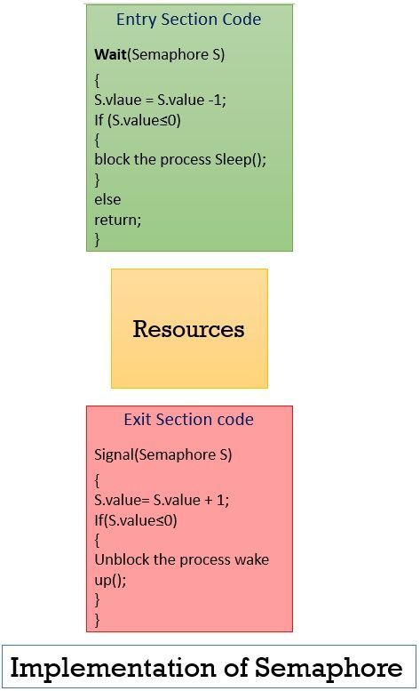

Slide 40
Semaphores are implemented in the system kernel. – The semaphore values are kept in a table stored in kernel memory.
A semaphore is identified by a number corresponding to a position in this table. – There are system calls for creating or freeing semaphores, as well as for executing the wait and signal operations. These operations are executed in supervisor mode and hence atomically (interrupts are disabled in supervisor mode).

Slide 41
Classical problems
The classical problem in concurrent programming are:-
1) The producer/consumer:- This problem is generalized in terms of the Producer-Consumer problem, where a finite buffer pool is used to exchange messages between producer and consumer processes.
2) The reader/writer:- In this problem there are some processes that only read the shared data, and never change it, and there are other processes who may change the data in addition to reading, or instead of reading it.
There is various type of readers-writers problem, most centered on relative priorities of readers and writers.

Slide 42
